Slide 1
Good Presentation Practices
Toward Better Presentations at RE
(Standalone Version)

Slide 2
Foreword…
We tried to follow our own “good practices” in doing this document…
However, this slide deck is NOT always a good example of how a presentation should look. This is because we developed this material in a way that allows you to read it to yourself, unlike when you prepare slides for a presentation to an audience.
Some wordy slides, like this one, would be removed if we were to present this material to an audience.
Also read the notes attached to slides, they contain additional information.
Notes:
We have deliberately kept these slides minimalist – no header accents, footers, backgrounds, etc.
While we are using Powerpoint to capture these messages, this document is meant to be a dialog with you and not a one-way delivery of our message to you.

Slide 3
Who are We (to provide guidance on this topic)?
Interaction Chairs:
Helping everyone having an even better experience at RE’13 through engaging with others…
David Callele
Martin Mahaux
Notes:
You may or may not know us but we are among the more outgoing members of our community and have a genuine interest in helping others learn how to engage with their audiences. Feel free to come up and chat with us any time!

Slide 4
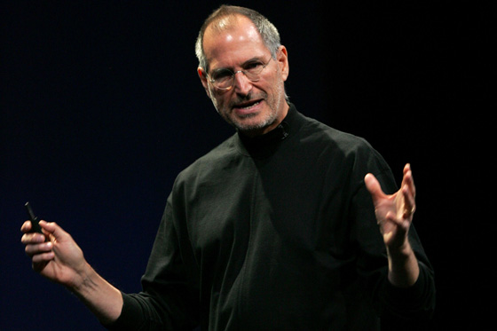
Table of Contents
Background: Why we need GPP’s
Content
Formatting
Interaction & Body
Alternatives ?
Notes:
A quick overview of what we cover in this slide deck

Slide 5
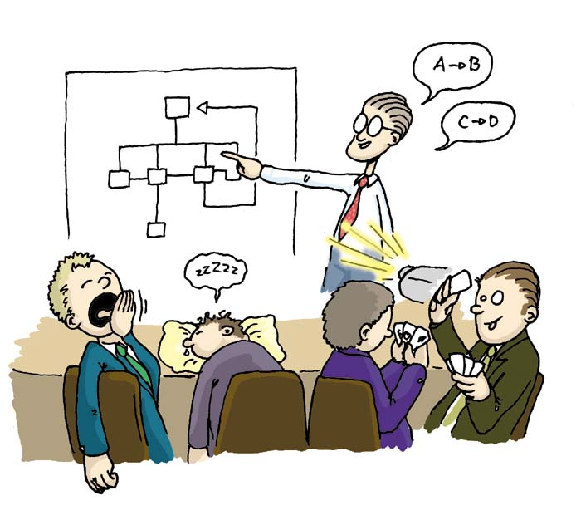
Why Good Presentation Practices’s ?
Presentations are the main communication channel at the RE conference
They are not
good enough!
Formatting
Content
Interaction
All of these matter!
Notes:
Please engage with your session chair as early as possible so that the session chair can be more helpful to you (the presenter) and the audience. The chair will work with you, the presenters, to ensure that your presentation quality is there, that you feel good, that you are prepared to deliver the best presentation that you can. The session chairs are responsible for helping you to succeed with your presentation and they keep an eye on the time (if you don’t), they facilitate questions and answer sessions, and simply do their best to ensure that everything goes well.
Please do your best to forward your presentation to your session chair as early as possible so that they can review the material and provide feedback if necessary.

Slide 6
I want Feedback, Collaborations!
We want Inspiration, Learning!
Notes:
Isn’t this slide amazingly effective?

Slide 7
Why are you here ?
You are here for the Audience
They want to learn about your topic
They want to be inspired but
They don’t want to know everything
You are here for You
You want some feedback
You want to invite people to collaborate
Notes:
Present yourself quickly – Why are you the right person to talk about this topic? This might include a quick word on past work – skip this slide if the Session Chair did such a great job that all has been said already.
It is always useful to know who is in the audience… If the session Chair did not characterize your audience for you, a simple question at the beginning of your presentation might help you to understand who is in the audience and to connect with them

Slide 8
Goals and Stories…
First identify your goals:
What do you want to give the audience?
What do you want to get from them?
Next prepare a story that achieves your goals:
People are more engaged by stories than by lectures
Notes:
A story? Well, yes… The traditional story arc consists on an inciting incident, a conflict and a resolution. In research this is the context of the problem, your research question(s) and your research results.
Consider using characters to help you think through your story… The character’s journey is the mental journey that your audience must take to follow your work.
A story board is a great preparation tool - consider developing a story board before you create any of your slides… Think through the timeline of your story (your work), sketch some visuals that illustrate your thinking and remember, these are sketches for YOU, you don’t have to be an artist to use this technique to achieve great results ☺
Make sure your story reflects the title of your paper: this is what attracted the audience in the first place!

Slide 9
Generic Research Outline
Self-introduction (skip if done by Chair)
Value Proposition (Teaser)
Background & Motivation
Research Question / Problem
Methodology: strengths and limitations
Results
Conclusions
Future Work
Notes:
Really think about the original contribution made by your work…
Does it highlight a new problem? Then spend more time on Motivations & Background.
Does it use an original and particularly useful methodology? Then tell us about the methodology, otherwise present only a brief summary. We know your methodology is OK since your paper has been accepted… So tell us only if it has some value in telling about it.
You have interesting results? Can they be applied to practice ? Then tell us how!
Can the results be used by other researchers? Tell us how…
You have great plans for the future? You want to invite others to join you? Tell us how to be a part of the future…
You want to discuss your conclusions with the audience? Then spend more time on the conclusions, and invite people to react, to share…

Slide 10
Generic Industry Outline
Company Introduction (skip if done by Chair)
Value Proposition (Teaser)
Background & Motivation
Experience Report
Implication for Research
Conclusions
Call for Collaboration / New research agendas items
Notes:
Industry presentations have the same deliverables as research papers: what are you bringing to the audience ?
This is a generic outline and it may not apply to your circumstance…
Obviously, you can present your material in any way that you choose but please be responsible about this… There should be a good reason for you to have a different structure and your audience does have some expectations of you… remember that you are presenting a narrative so choose accordingly.

Slide 11
Notes:
Please don’t make a slide like this…

Slide 12
Formatting
Less content is better
Slide text only anchors your speech
Audience should listen, not read
Minimum size 24 point font
Use color with caution
Possibly colorblind people
Projectors skew colors
Pictures are worth a thousand words…
…if relevant !
Notes:
Remember the 10 – 20 – 30 rule (scaling as necessary)
10 slides (maximum), including title and closing slides, for a presentation that lasts
20 minutes. Remember that the audience tends to sit toward the back so always use at least
30 point type so that everyone can read your slide.
Another rule is that the smallest typeface should be ½ of the age of the oldest person in the room… Or, a normally sighted person should be able to read the slide from the very back of the room.
Another heuristic: Use less than 30 words per slide. However, 0 to 5 words and a quality visual will usually impact your audience better than 30 words…
To be as safe as possible: have your slide in Powerpoint and PDF formats, stored in the cloud and on a USB key. You can even generate a self-contained PPS.
Many older data projectors (more than 2-3 years old) have trouble interfacing to Apple products so you may be forced to present on a Windows machine even if you are an Apple product user – please try to test your presentations for Windows compatibility.
DID YOU NOTICE THAT THE SLIDE FORMATTING CHANGED BETWEEN SLIDES? Be careful when changing formatting between slides. Inconsistent slide formatting can feel “wrong” to the audience so use inconsistent formatting with caution…

Slide 13
Can anyone provide an example of an industry actively using a formal requirements notation?

Slide 14
Interaction
Keep your audience awake and interested. For example:
Ask (real) questions, and actually use the answer to build up your argument.
Use instant polls (show of hands)
To illustrate polemics
To understand your audience
To see if people agree or not
Notes:
When asking questions to the audience, recognize the value of your audience. Ask about what they think of some polemic (potentially contentious) position, potentially by doing a poll, or by asking an open-ended question. Even if nobody answers, this technique helps you to engage with the audience.
If someone answers with something unexpected, or disagrees with you, you can ask the audience for their opinion → who agrees with the opposing position to determine the degree of opposition to your assertion(s). Ask why they disagree, then we suggest that you try to recognize the valuable contributions of both points of view. Consider making an offer to discuss the matter further after the presentation if you can’t close the debate during the presentation. And, if appropriate, remember that you can always refer the audience to your paper…
You can ask your audience whether they have specific knowledge about certain areas touched upon by your work. You can increase engagement by polling your audience to see whether they think your research hypothesis was proven or disproven by your work.
Remember that you can always poll your audience on anything that you would really would like to know about – after all, they are all RE researchers or practitioners just like you! Just be careful to manage your time – everyone has to have their turn to present.

Slide 15
Body Language
Your body language matters
Prepare well, rehearse-rehearse-rehearse…
Then relax and be ready for the unexpected to occur
Even if a mistake happens your audience will understand – they have been there too! Errors are OK – people can enjoy them too!
Voice projection
Do your best to fill the room with your voice
You know how frustrating it is when you can’t hear or understand the speaker…
Notes:
If you are comfortable and having fun then your audience will have fun along with you.
RELAX!!! Everyone really is there to hear what you have to say and to learn from you so enjoy the opportunity.
If you have a quiet voice, consider asking someone you know for help on learning how to project your voice out to the audience. The techniques may seem weird at first but stage actors have been using them for a very long time.

Slide 16
Alternative media
Think about your goals again:
Do you need words on this slide?
Do you need this slide at all?
Do you need a slideshow at all?
Can you say it more simply? Or in a way that will engage people more?
Notes:
Do you have to use a slideshow ?
Slides are expected in our conferences, but in some disciplines conference presentations are done without slides. No slides means the audience will concentrate on you, and you will concentrate on the audience.
Be creative, but respectful... Can you deliver your message with… a poem, a song, a role-play, a video… Big Post-its, Big Posters…? Something that will make your presentation more memorable without distracting from delivering your message? Feel free to try out something new but make sure that you have tried it at home first to ensure that your audience still engages with you.

Slide 17
See you in Rio for a
Great Presentation!

